Slide 1
FORMATS OF GEOSCIENCE DATA
Some geoscience data is in text form
Advantage: text data is easily read, e.g. comma-separated values (CSV)
Disadvantage: slow to read and write text if data set is large
Python: can easily read plain and CSV text using built-in functions or in Pandas software
Binary form is preferred for large data sets
Advantage: large data sets can be read or written very quickly
Disadvantage: need helper software to understand data
Python: can read most binary data using available modules

Slide 2
FORMATS OF GEOSCIENCE DATA
TEXT
txt: simple text files with varying levels of formatting
csv: comma-separated values – spreadsheet, database of data in tabular form (think Excel)
BINARY
Netcdf: network common data form – array-oriented scientific data (often spatial data)
Grib: World Meteorological Organization data format
HDF
CSV: https://docs.python.org/3/library/csv.html
Netcdf: https://www.unidata.ucar.edu/software/netcdf/
Grib: https://www.cpc.ncep.noaa.gov/products/wesley/reading_grib.html

Slide 3
BENFITS OF BINARY FORMAT
Efficiently stores the data sets in disk files
Offer compression, for smaller file sizes and faster I/O
Are self-describing, containing metadata

Slide 4
THE COMPONENTS OF DATA
Dimensions: define the shape and size of a variable
Common
Spatial dimensions
Temporal dimensions
Other aspects of data
Dimensions are associated with coordinates
Common
Spatial coordinates: latitude, longitude, height/depth
Temporal coordinates: time

Slide 5
METADATA
Metadata: information about data that allows us to discover, process, and analyze data correctly
Describes the who, what, where, when, why, and how of the dataset
Example: observational data collected at a station – info about the site (location), conditions, exposure, how the instruments are calibrated, any changes

Slide 6
METADATA
Field-specific conventions are common, especially for government or lab associated data
Example: for a lot of weather and climate data, “CF” conventions
Units for variables
Physically descriptive long name for variables
Coordinate variables
Time (and units)

Slide 7
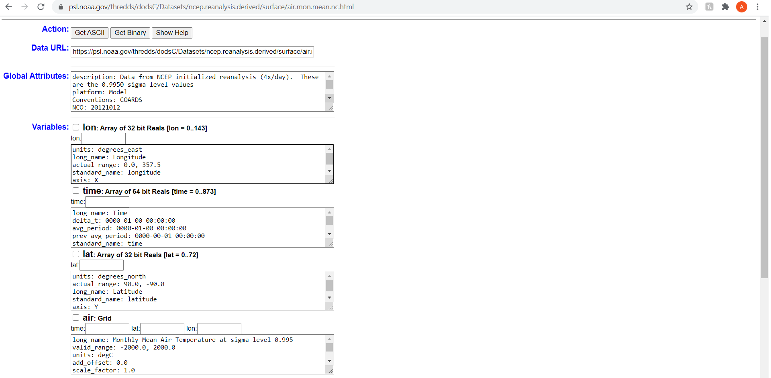
Image of metadata: https://psl.noaa.gov/thredds/dodsC/Datasets/ncep.reanalysis.derived/surface/air.mon.mean.nc.html
Additional useful information on dataset: https://psl.noaa.gov/data/gridded/data.ncep.reanalysis.derived.surface.html

Slide 8
METADATA
A good dataset should include metadata! Risky to use without
Separate file/documentation
Netcdf files – often a lot of metadata built in
WHAT ARE THE METADATA CONVENTIONS IN YOUR FIELD?

